Slide 1
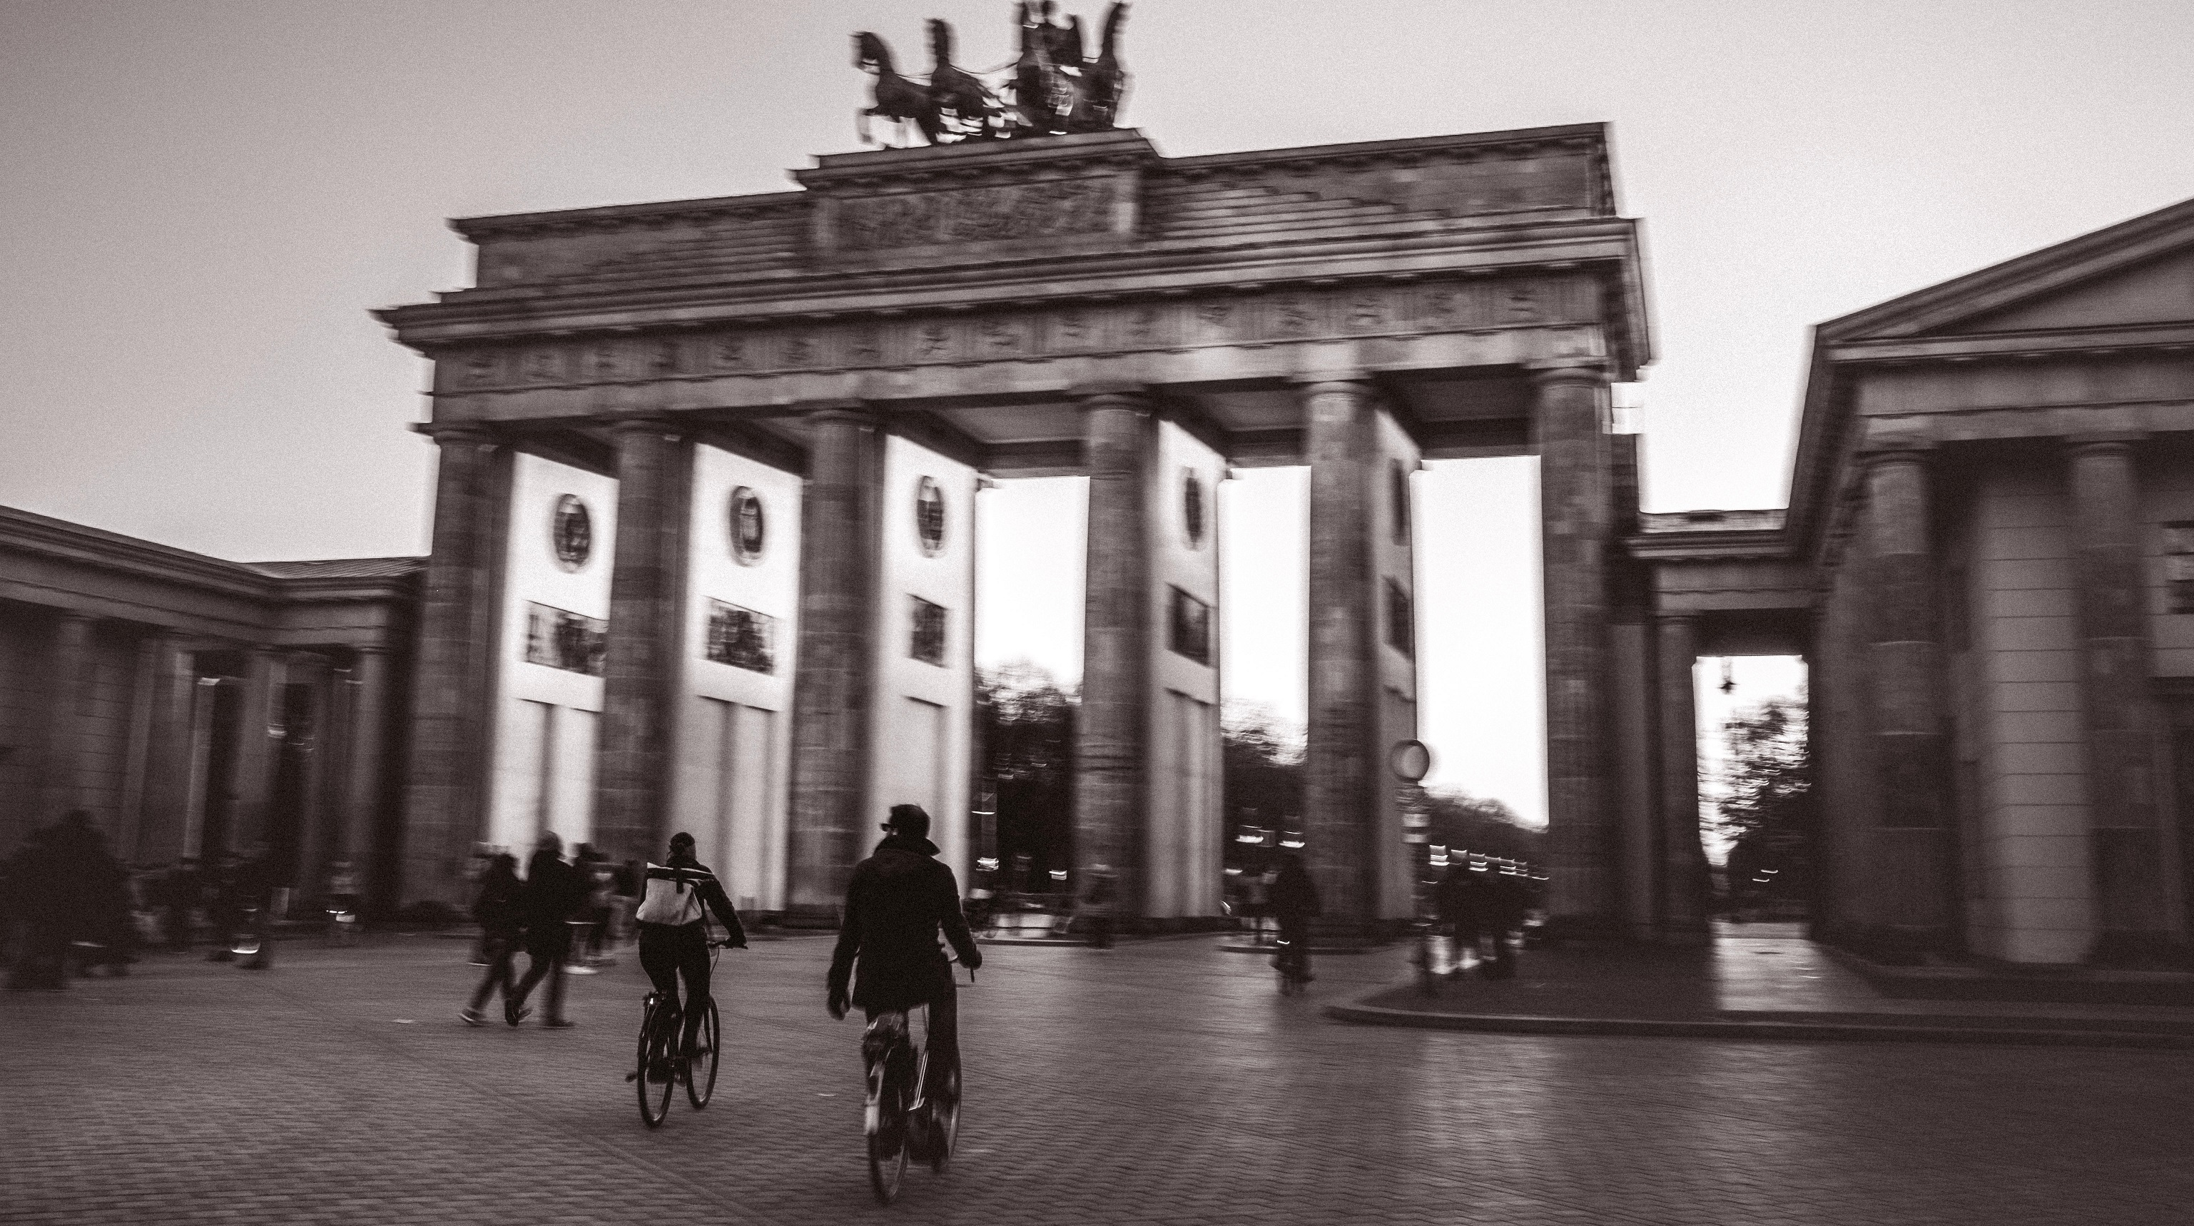
Criminal Statistics Involving Bicycles in Berlin
A Descriptive Analysis
by Daniela Yanakieva

Slide 2
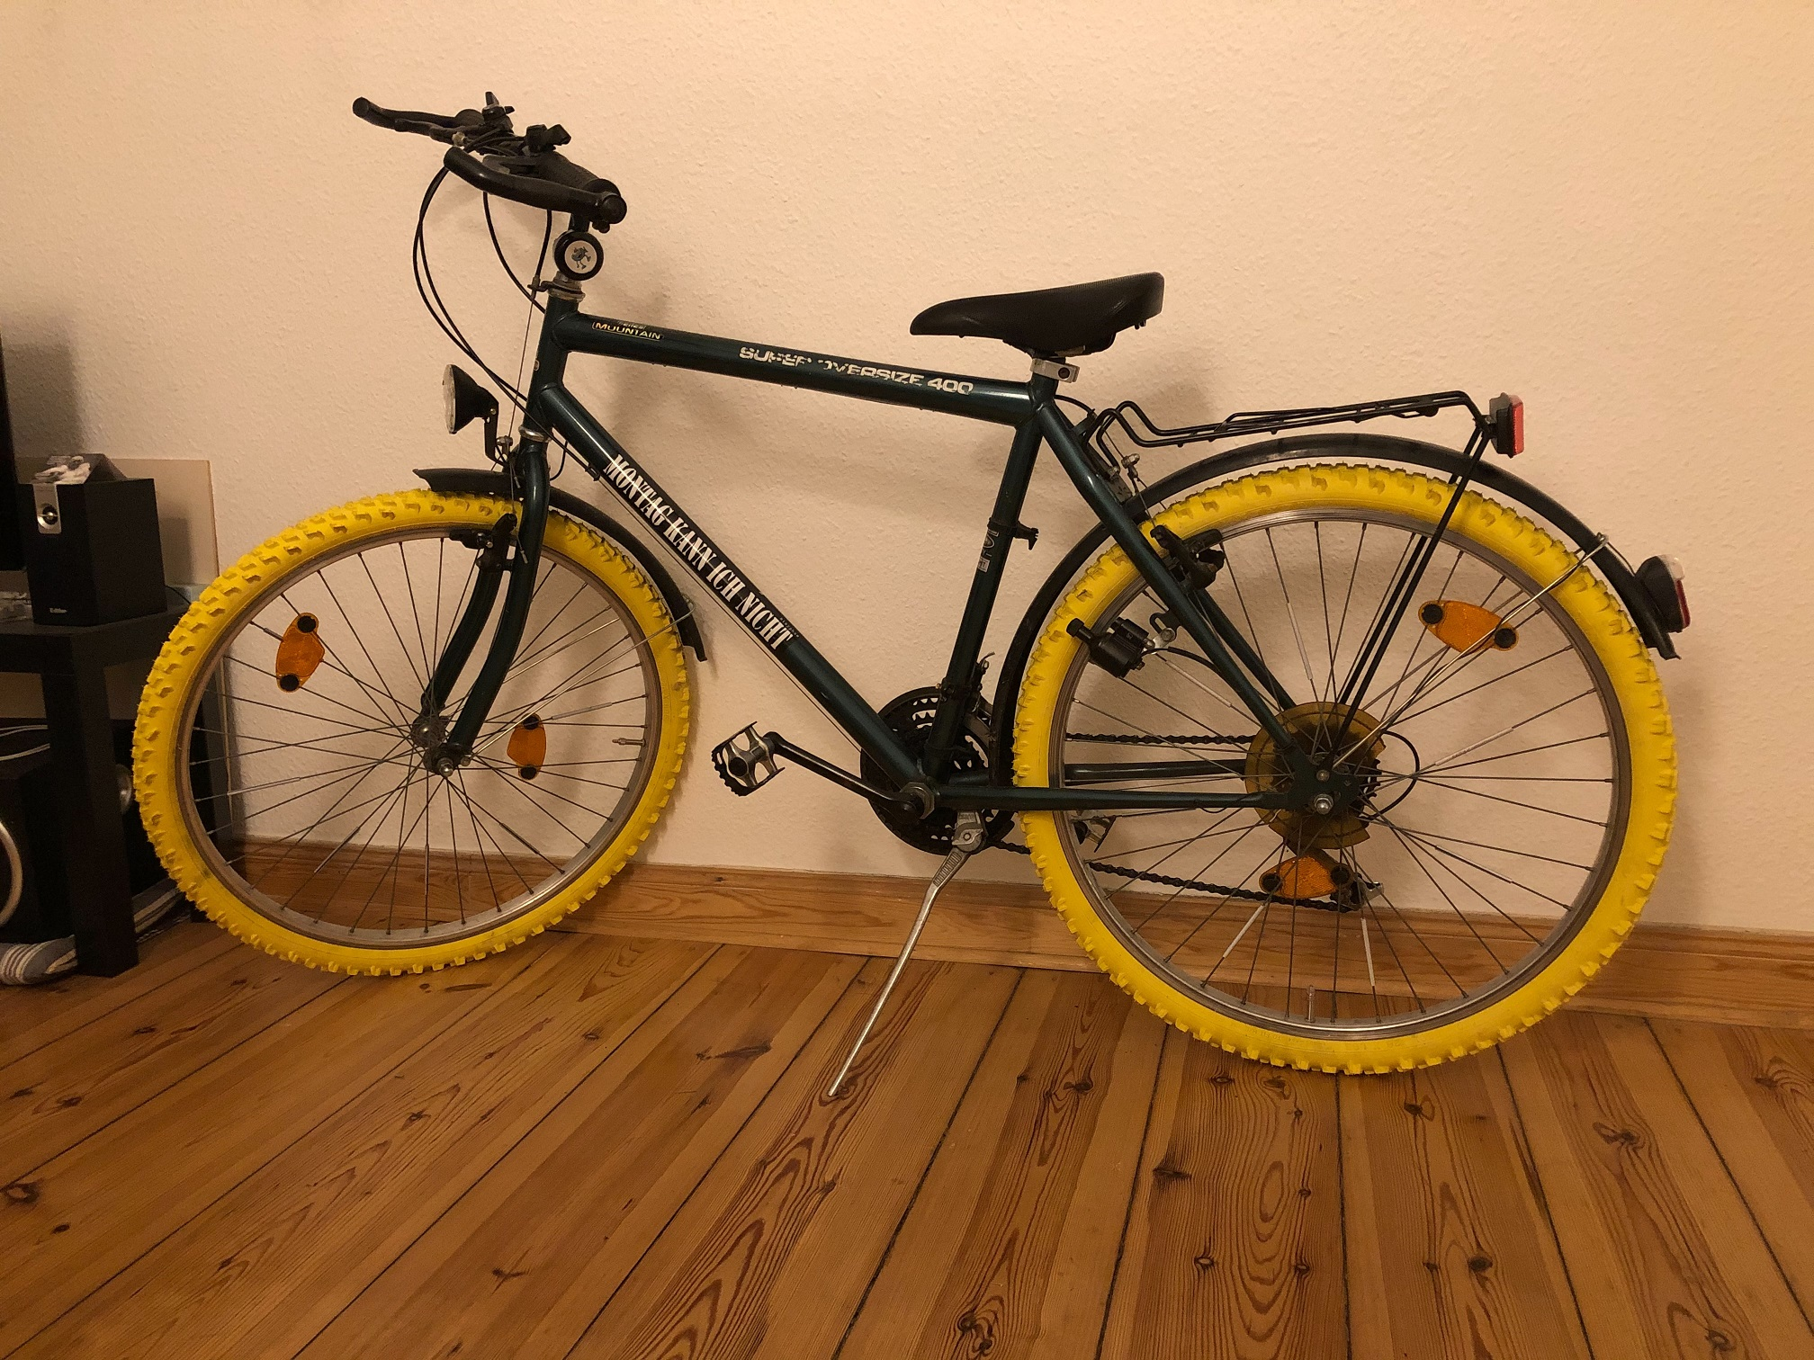
My Motivation
is my bike and my love for Berlin
My Datasets
come from Berlin Open Data
https://daten.berlin.de/

Slide 3
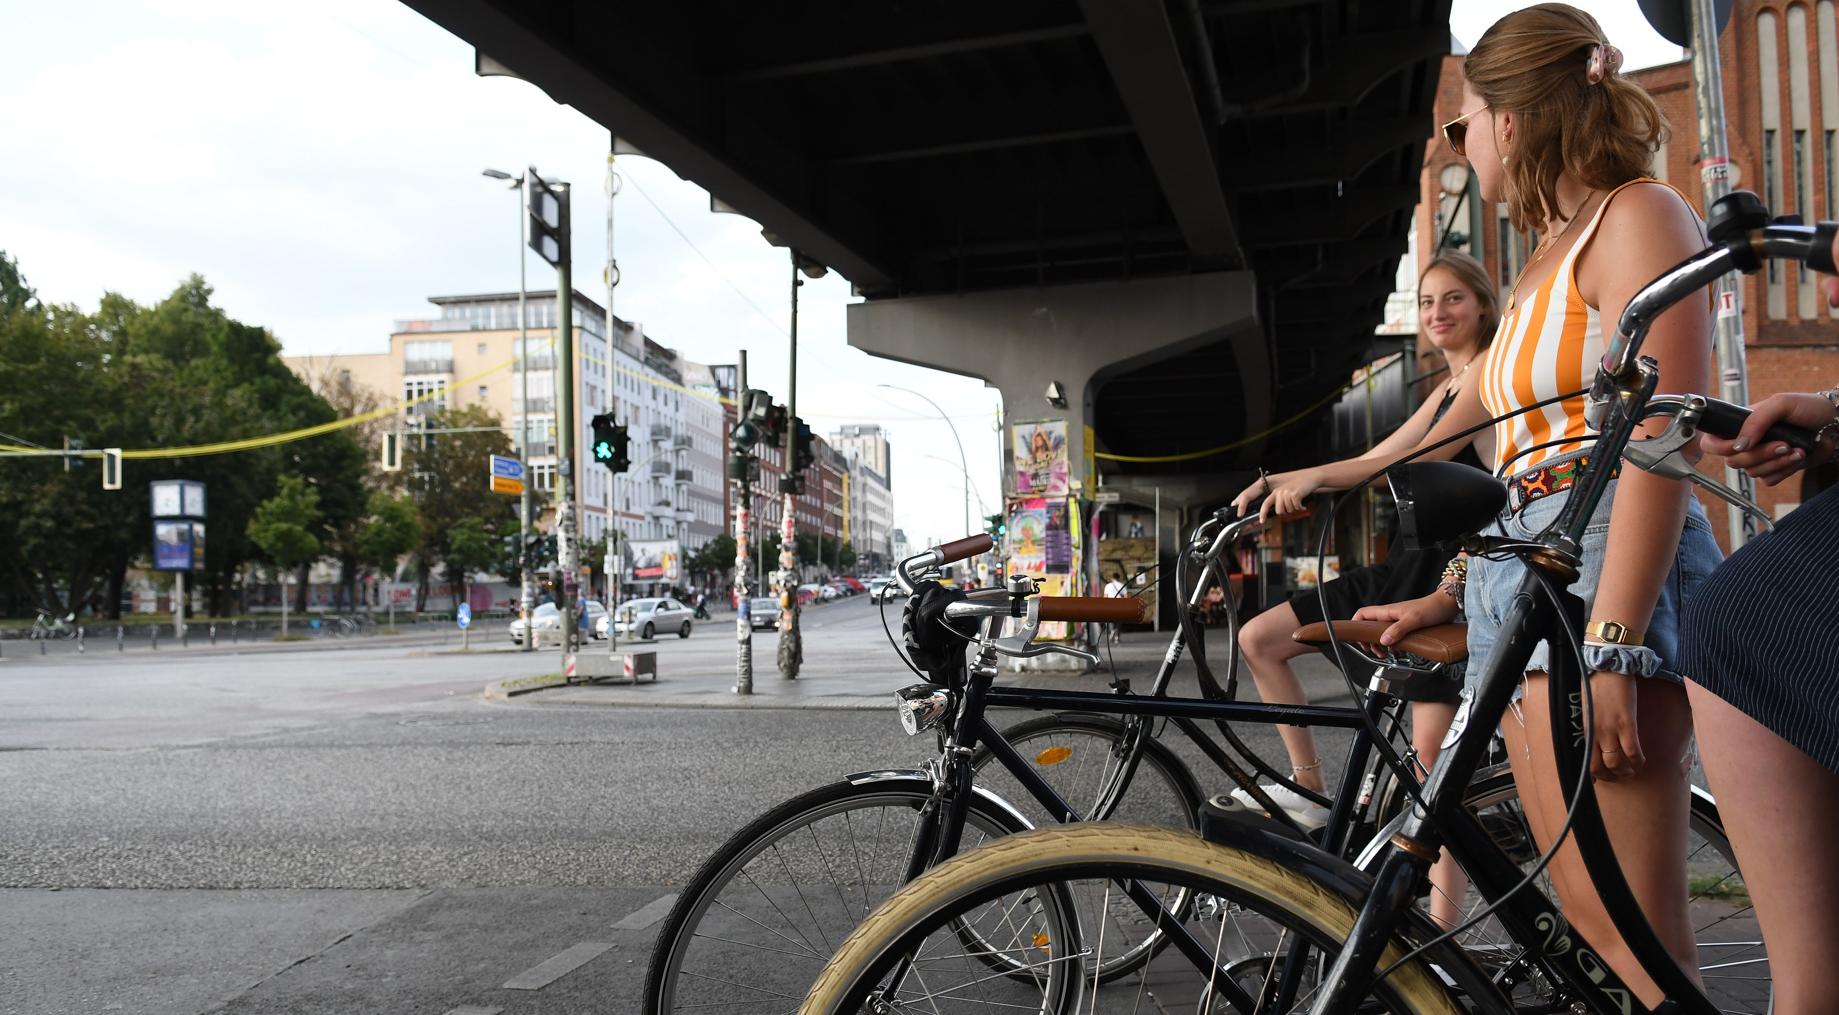
My questions:
1. Which are the districts with the highest theft and respectively the highest accident rates? Which are the ones with the lowest?
2. Which bike type gets stolen most often and which bike type corresponds to the highest amount of loss?
3. What is the share of accidents by accident severity by time of day?
4. Do more accidents and thefts happen at night?
READY...SET...LETS GO!

Slide 4
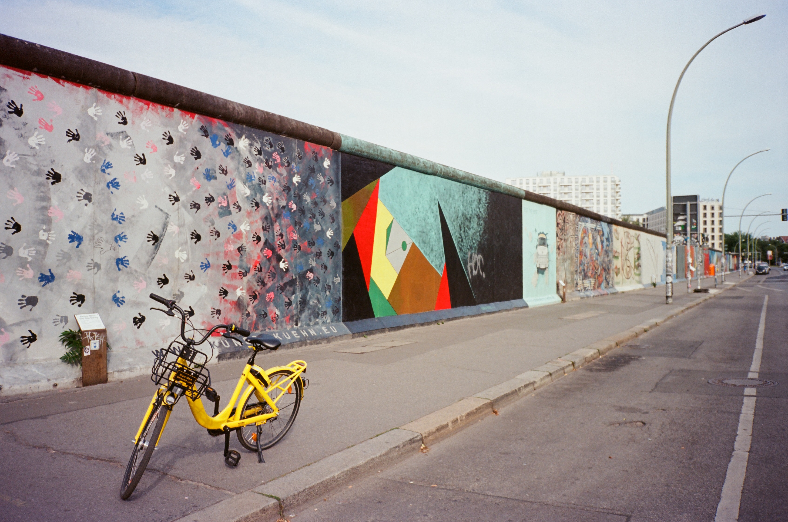
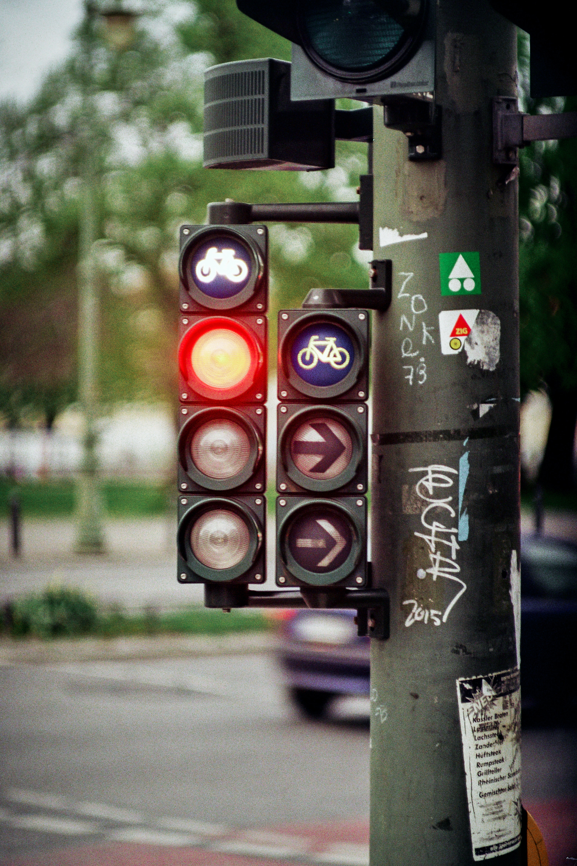
The Datasets:
File 1: Bicycle Theft Statistics in Berlin 2022 & 2023 by Berlin Police
Period of theft: start and end date and time
LOR: ID number of the area, created by the Senat for City Development and Living
Loss amount: the worth of the stolen bicycle(s)
Type of the stolen bicycle
Type of theft
File 2: Traffic Accidents Statistics Berlin 2021 by Bureau of Statistics Berlin-Brandenburg
Date and time of accident
Accident category by severity
Types of accident
Light conditions (daytime)
Road condition
Coordinates of the accident location
The Limititation:
Contain only data about the registered thefts and accidents by the Berlin Police

Slide 5
The Challenges:
Data Translation
Data Formats
Missing Data
Data in Multiple Columns
The Solutions
Using Python Dictionaries & Lists
Using Pandas datetime64
Extracting from available data
and assigning via functions
Collecting and summarising via function in a single column

Slide 6
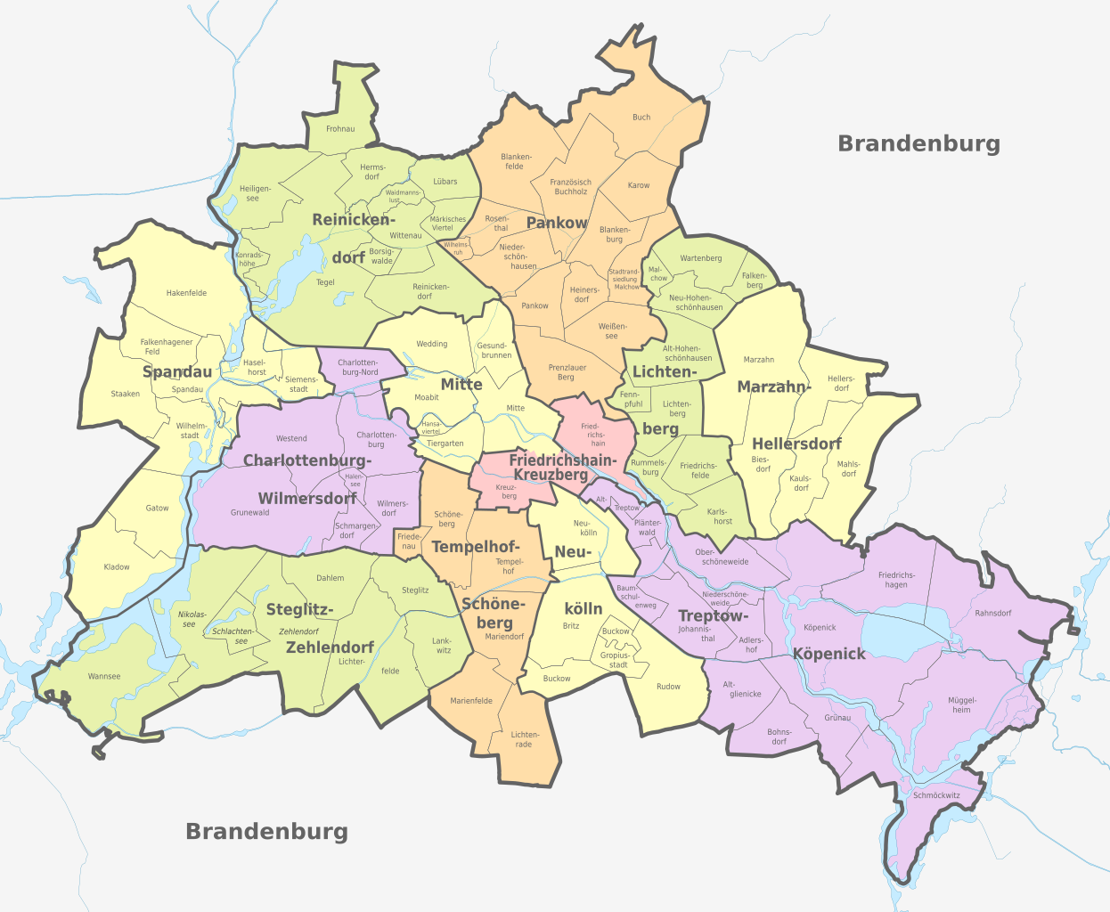
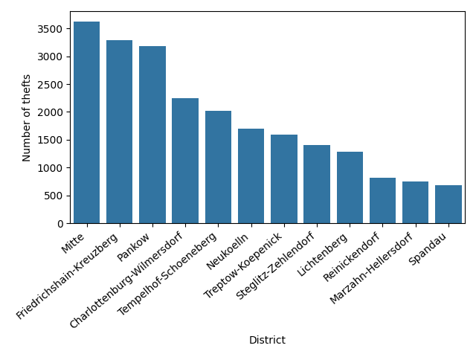
Which are the districts with the most thefts 2022?

Slide 7
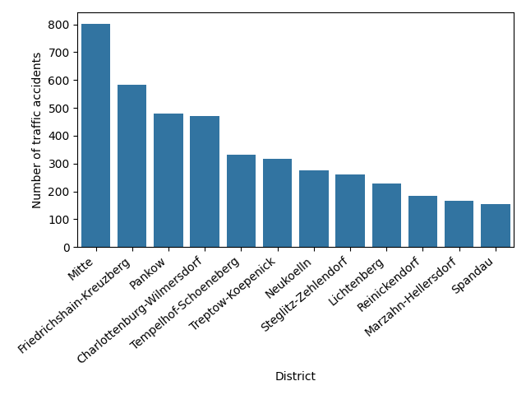
Which are the districts with the most traffic accidents 2021?

Slide 8
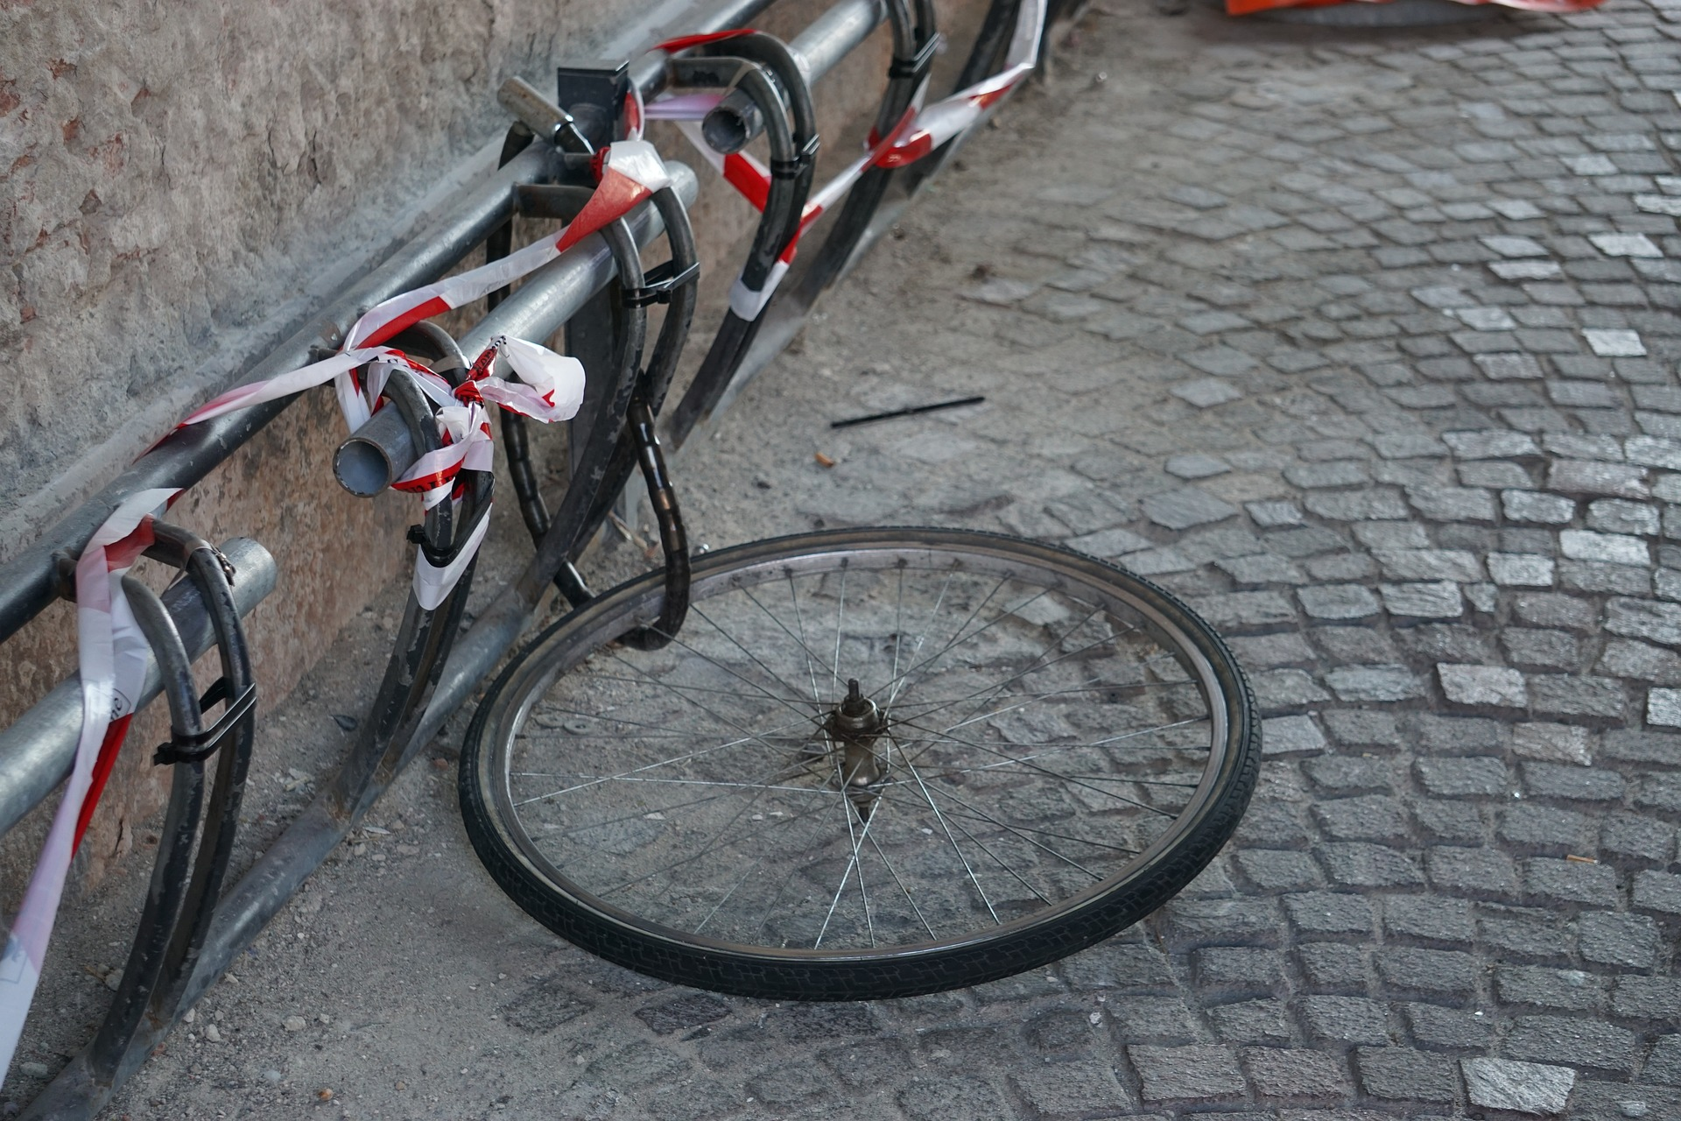
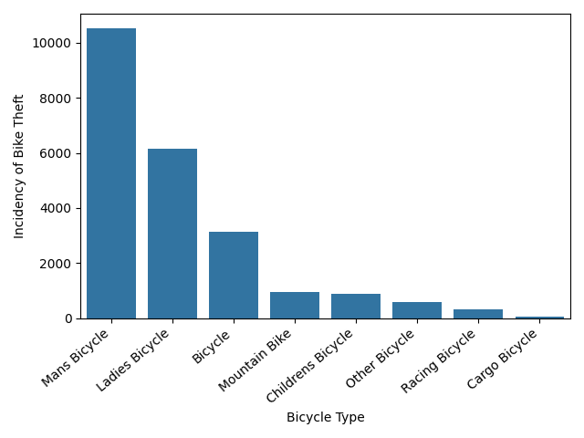
Which types of bicycle got stolen most in 2022?

Slide 9
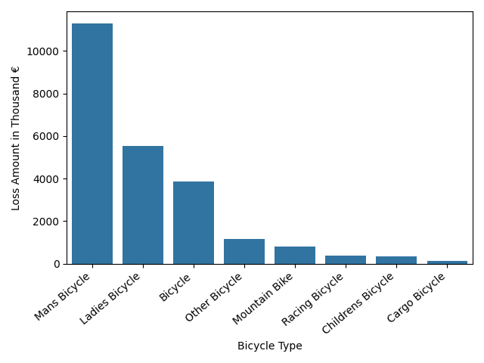
Which type of bicycle corresponds to the highest cummulative loss amount in 2022?

Slide 10
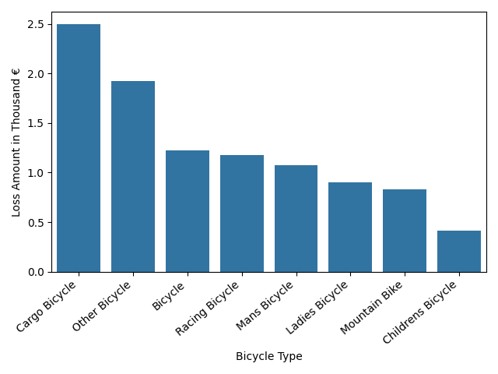
What was the average loss amount per bike category in 2022?

Slide 11
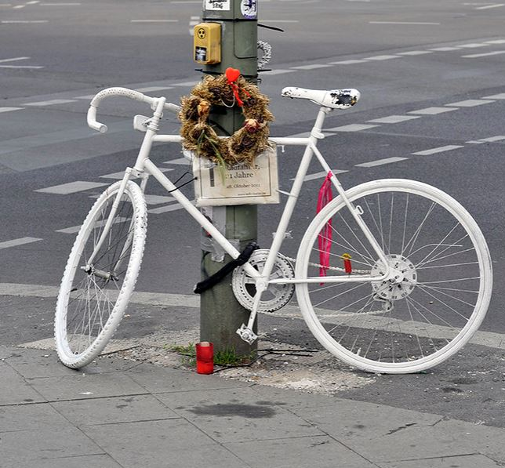
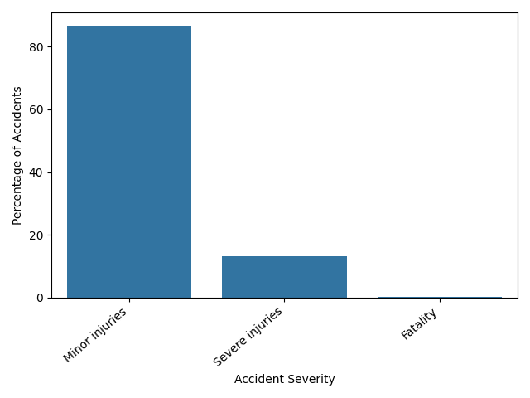
What was the share of accidents by severity in 2021?

Slide 12
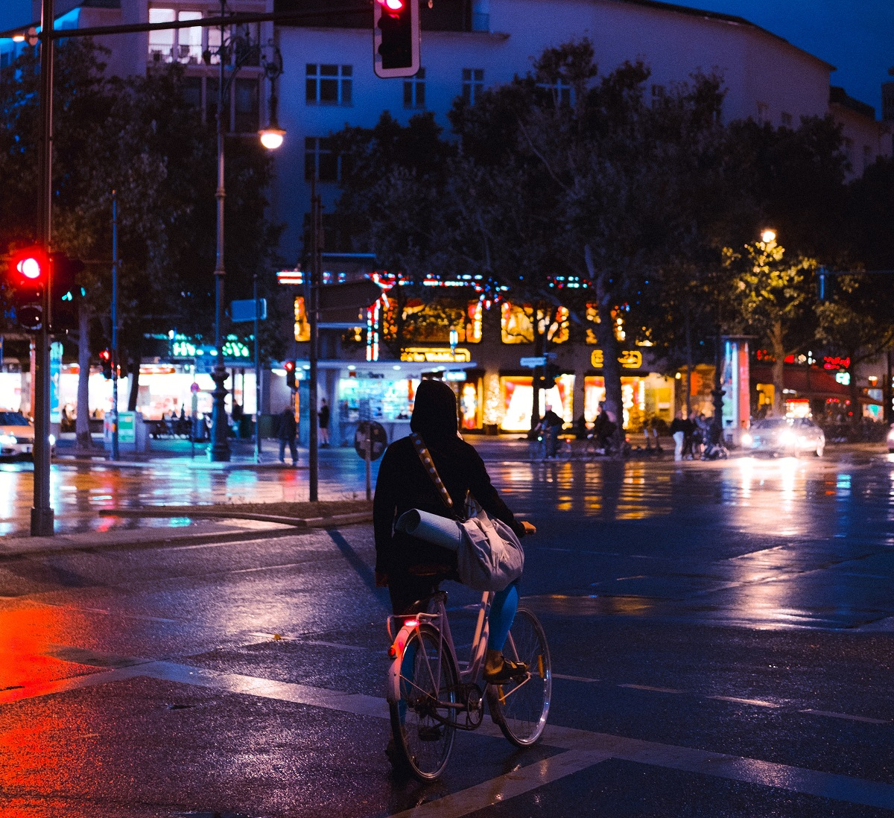
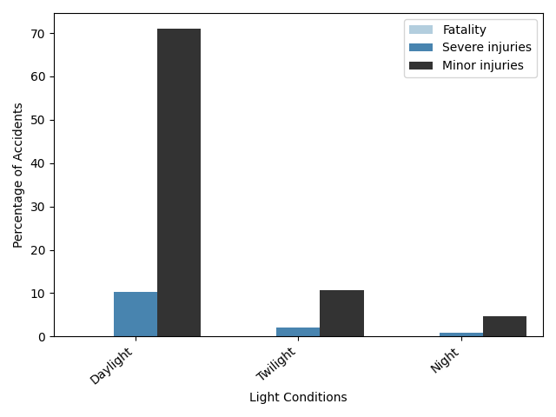
What was the share of accidents by severity and light conditions in 2021?

Slide 13
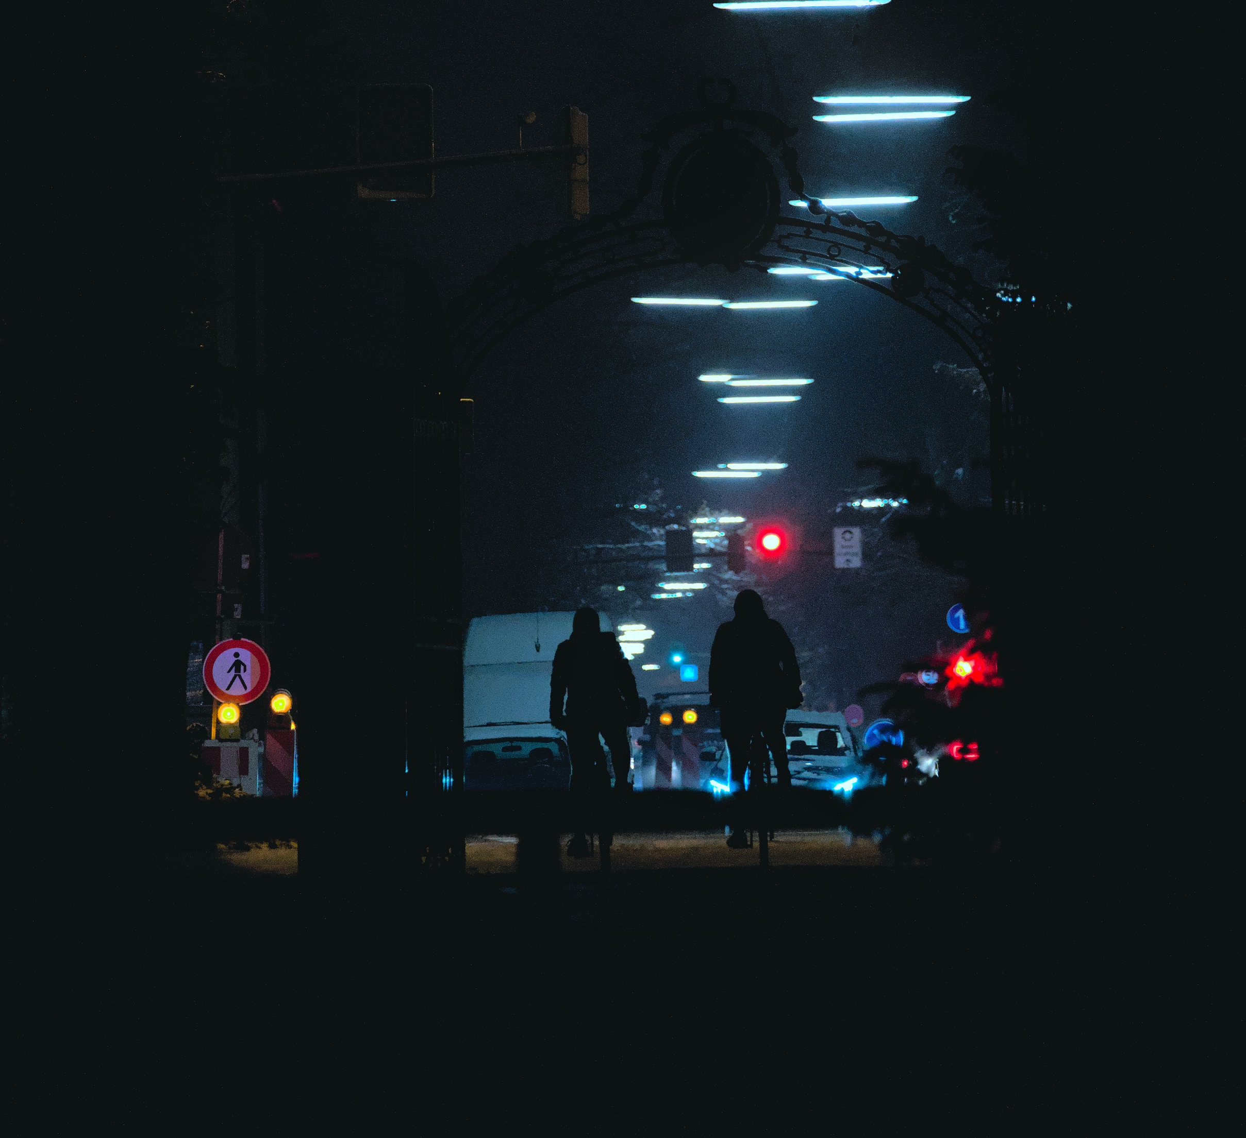
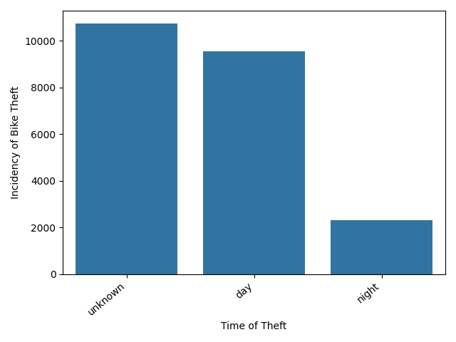
What was the share of thefts by time of the day in 2022?

Slide 14
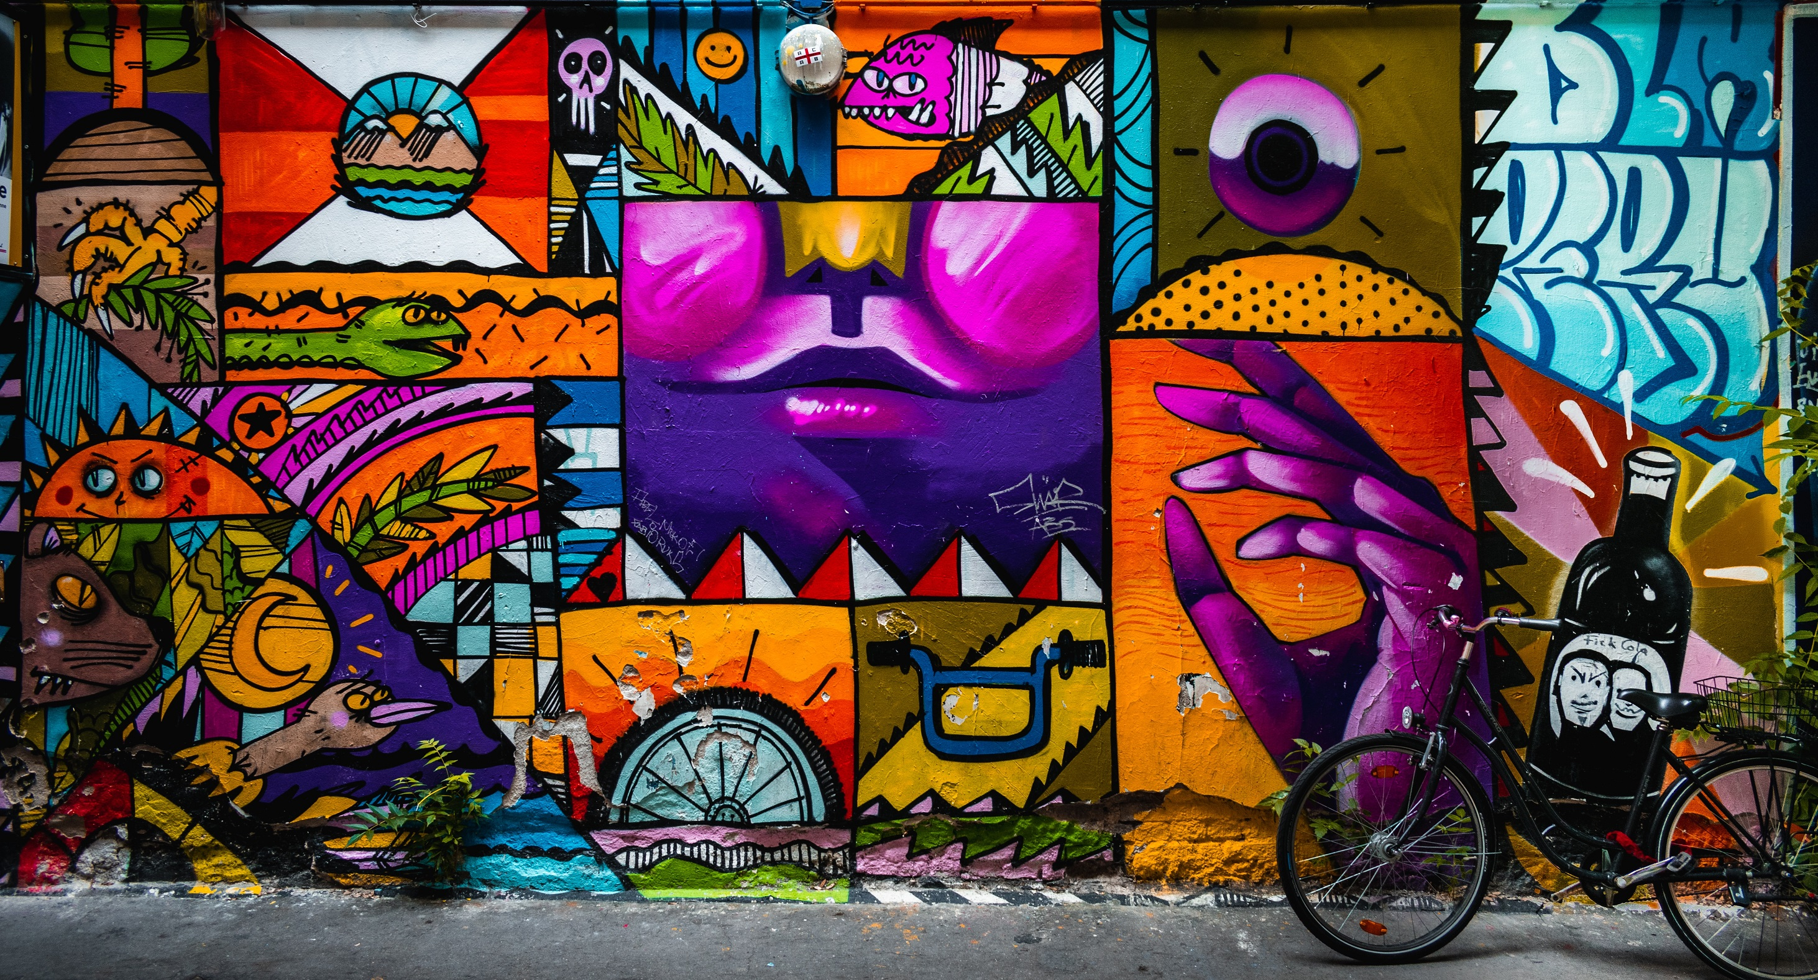
Conclusions:
The riskiest areas in Berlin for bike thefts and accidents are the busy famous tourist areas Mitte and Fridrichshain-Kreuzberg.
There were relatively few deadly accidents with bicycles involved in 2021 and all of them happened during the daytime.
In 2022 bikes in worth of more than 23 Million € got reported as stolen in Berlin.
According to the data the risk of being involved in an traffic accident with bike is way higher during the busy daytime.
It is not possible to determine whether the risk of bike theft is higher during the night in Berlin.

Slide 15
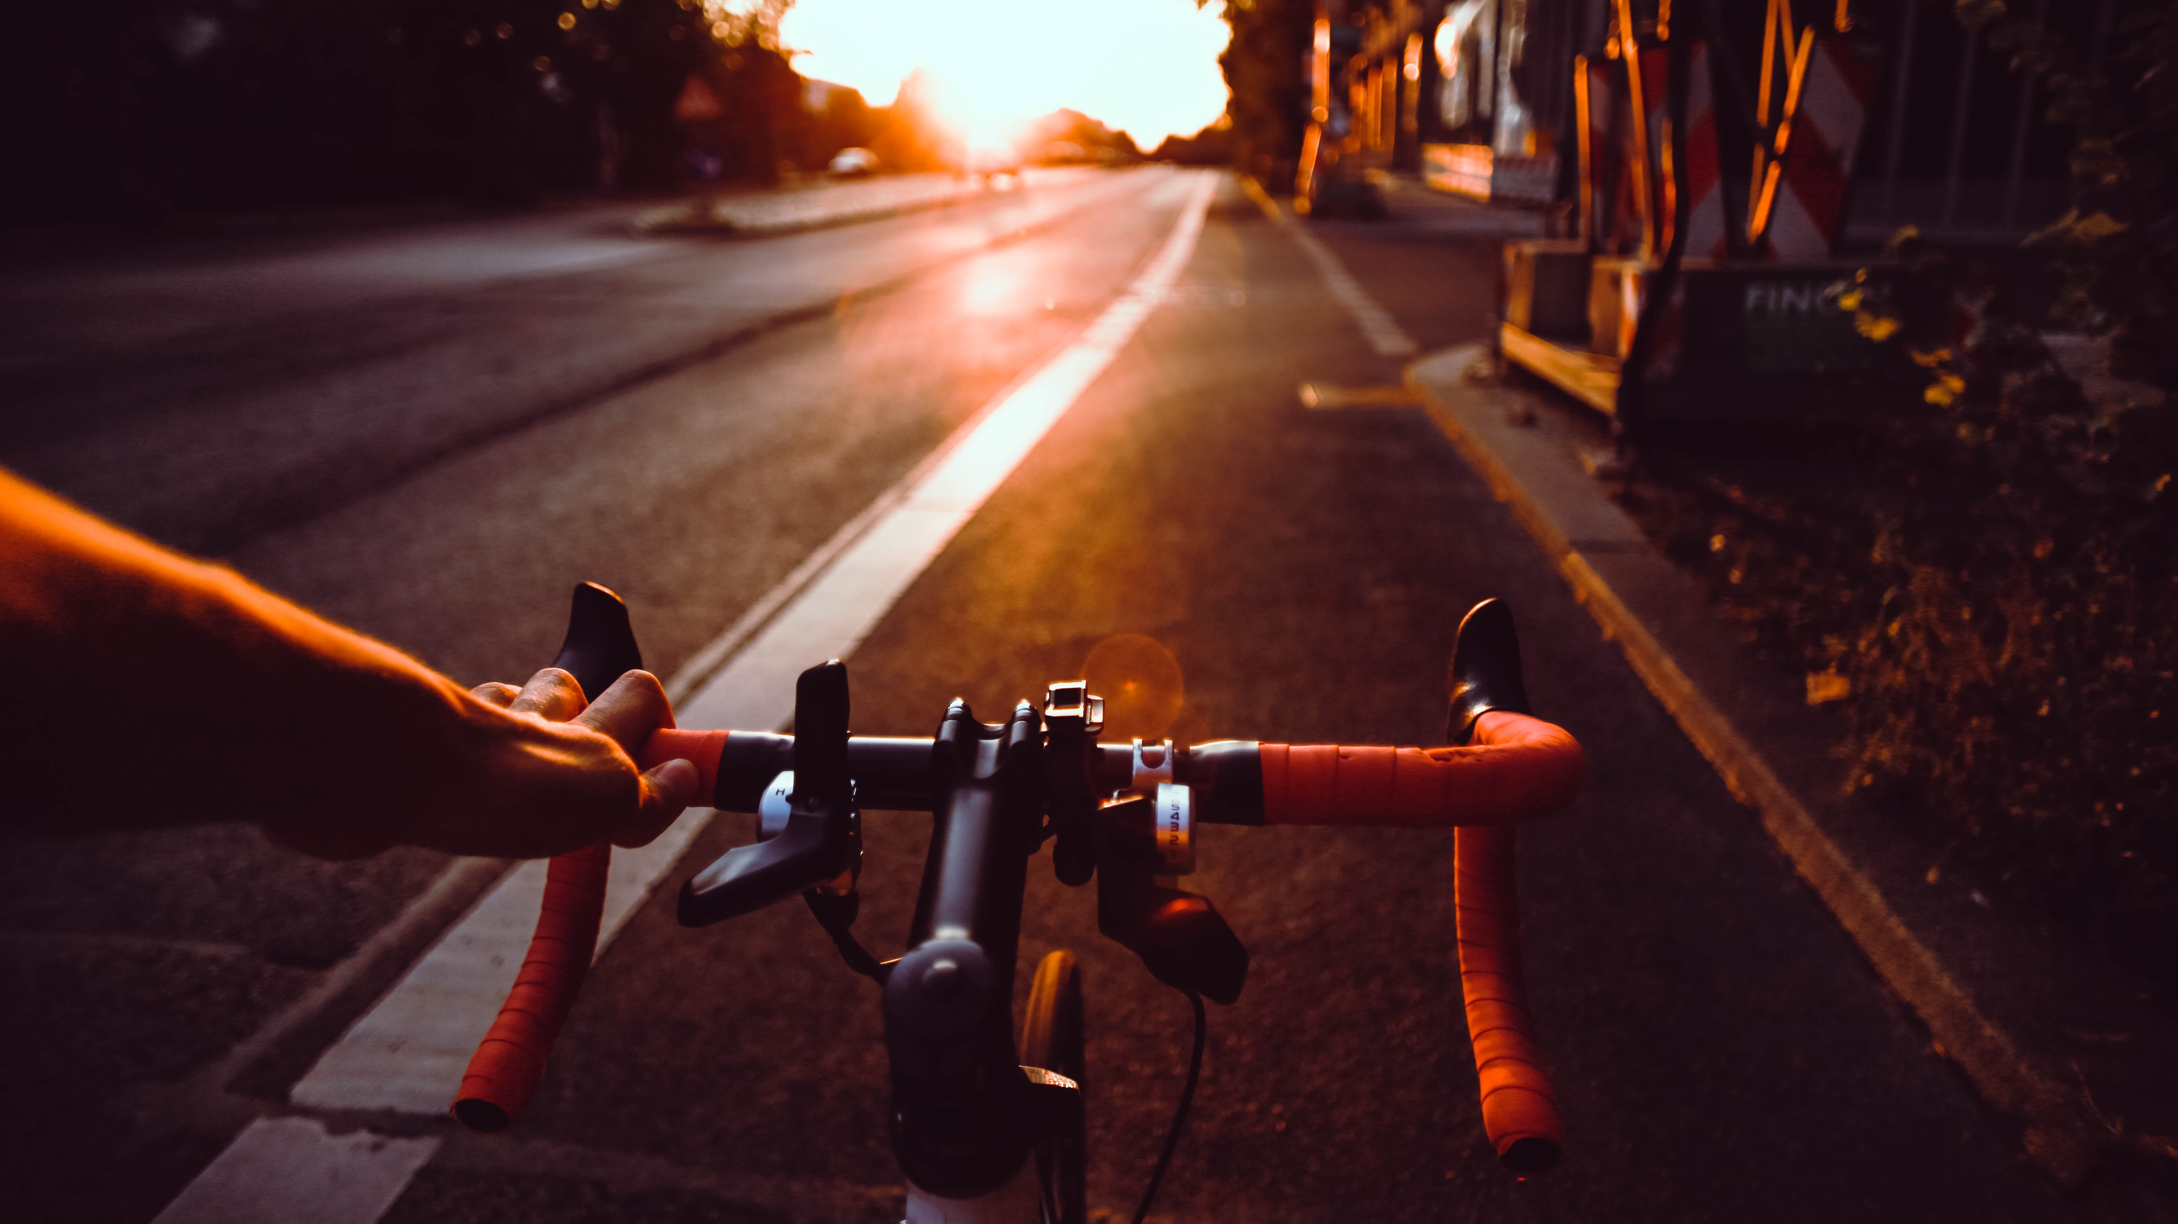
Possible Next Steps and Ideas:
Repeat analysis once data on thefts for 2023 is published and compare to national data
Analise coordinates data, identify dangerous areas (both theft and traffic accident), visualise data on a map
Programm an app that notifies users for dangers and risks in real time

